Slide 1
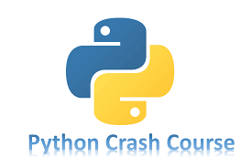

Slide 2
Chapter 9
CLASSES
Brief Summary of Chapter 9
Object-oriented programming (OOP) is a method of writing software where classes are used to represent real-world objects or concepts. You create objects based on these classes, and each object inherits general behavior defined by the class, while also allowing for unique characteristics. The process of creating objects from a class is called instantiation. OOP also allows you to define what data objects store and what actions they can perform. In this chapter, we will explore topics such as (creating and using a class), (working with classes and instances), (inheritance), (importing classes), the (Python standard library), and (styling classes).

Slide 3
Creating and Using a Class
A class in Python is a blueprint for creating objects that bundle data (attributes) and behaviors (methods). The class is defined using the class keyword (e.g., class Dog:), and the __init__() constructor method in Python is called automatically when a new object (instance) is created from a class. It’s used to initialize the object's attributes with specific values. Inheritance allows a child class to inherit attributes and methods from a parent class, enabling code reuse. The child class can also override or extend the parent class's methods to modify or add functionality.
An instance is an individual object created from a class. For example, my_dog = Dog('Willie', 6) creates an instance of the Dog class with specific attributes. Attributes are properties of an instance, and they are accessed using dot notation, such as my_dog.name. Methods are functions defined within the class and are called on an instance using dot notation (e.g., my_dog.sit()). Methods can modify or interact with the instance's attributes, performing actions that define the object’s behavior. Methods from a parent class can also be inherited by a child class, and the child can override them to change their behavior if needed.

Slide 4
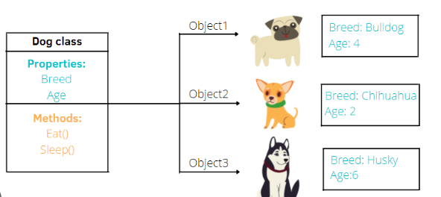
Example (Page 158 - 161)
The Dog class is a blueprint for creating dog objects. The __init__() method is a built-in function that automatically runs when a new instance of the class is created. It takes self, which refers to the individual dog(the current instance of the class), along with the name and age parameters, and sets them as the dog’s attributes (self.name and self.age). The sit() and roll_over() methods make the dog sit or roll over by printing messages with the dog’s name. The self keyword is used to access and change the attributes of each dog, so every dog has its own unique name and age.

Slide 5
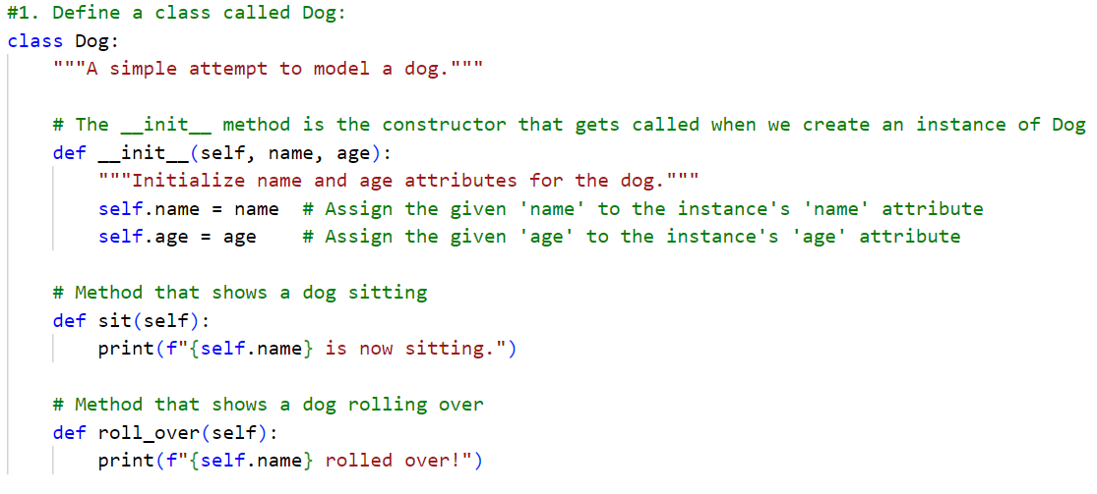

Slide 6
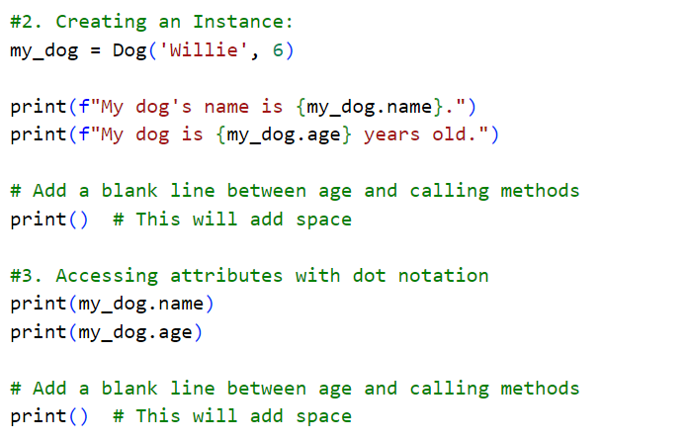

Slide 7
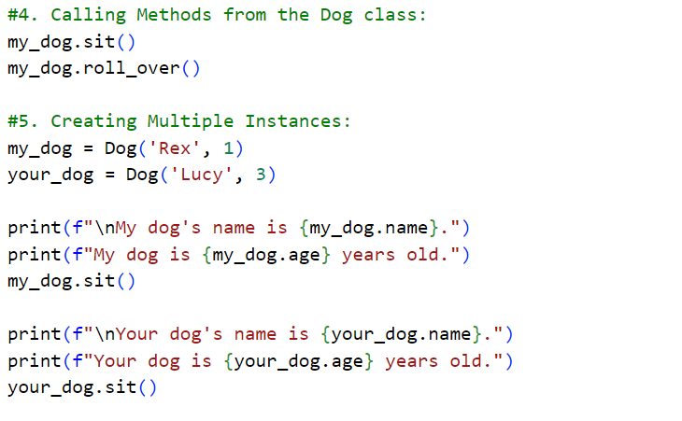

Slide 8
Working with Classes and Instances
In this topic, we will be creating a Car class to represent a car and demonstrate how to work with attributes and methods. We will start by setting a default value for an attribute, self.odometer_reading = 0, which initializes the car's mileage to 0 when a new instance is created.
Then, we'll modify the attribute's value directly using dot notation, as shown with my_new_car.odometer_reading = 23. This line accesses the odometer_reading attribute of the my_new_car instance and sets its value to 23, directly updating the car's mileage.
Next, we’ll demonstrate modifying an attribute’s value through a method by using the update_odometer() method, which allows updating the odometer reading with a given mileage.
Lastly, we will show how to increment an attribute’s value through a method by using the increment_odometer() method, which uses self.odometer_reading += miles to add the specified number of miles to the car's odometer reading.

Slide 9
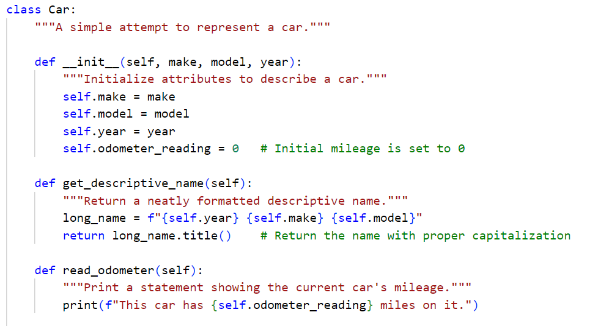
(Page 162 - 163) parent class - File name car.py

Slide 10
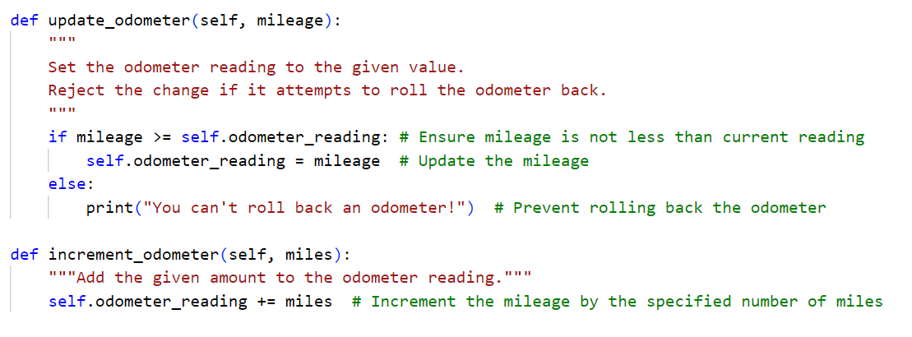
Page 165 - 166

Slide 11
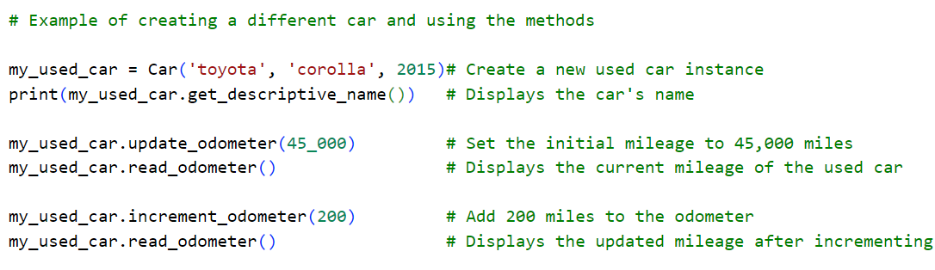
Page 166

Slide 12
Inheritance
In this section, inheritance is used to create a child class (like ElectricCar) that inherits from a more general parent class (Car). The __init__() method initializes a class's attributes, and by using super(), we call the parent class's __init__() method to inherit its attributes in the child class.
The get_descriptive_name() method formats and returns a string describing the car, while describe_battery() in the child class ElectricCar provides details about the battery size. The fill_gas_tank() method is overridden in the child class to reflect that electric cars don’t have gas tanks.
Additionally, composition is introduced with the creation of a Battery class, which is used as an attribute in the child class ElectricCar, representing the relationship between the car and its battery.

Slide 13
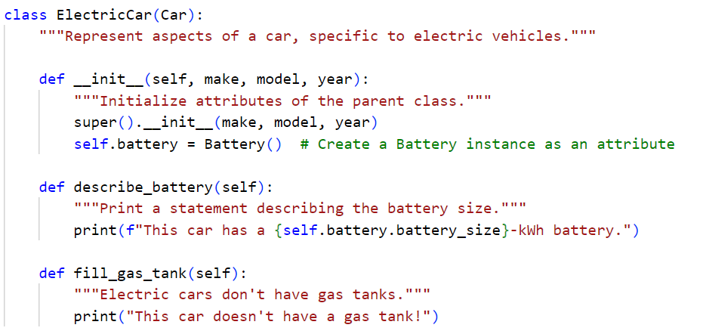
(Page 167 - 171) child class - File name electric_car.py
Then Place the ElectricCar class below your existing Car class.

Slide 14
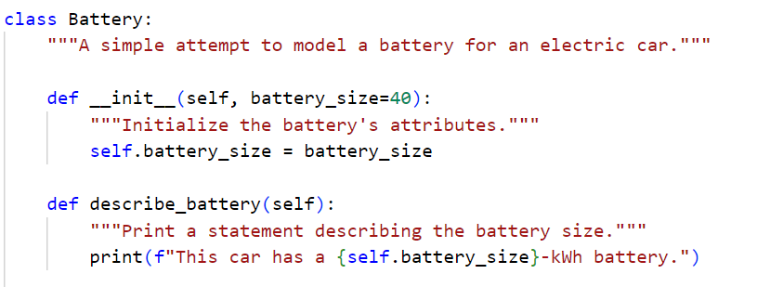
Page 170 - 171

Slide 15
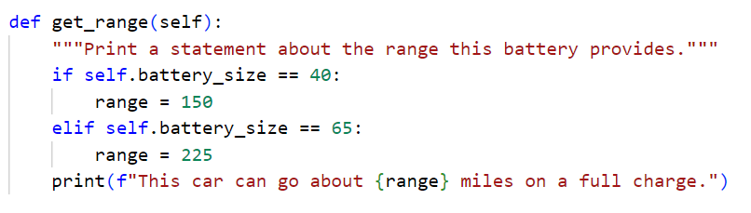
Page-172
The range function should be part of the Battery Class

Slide 16
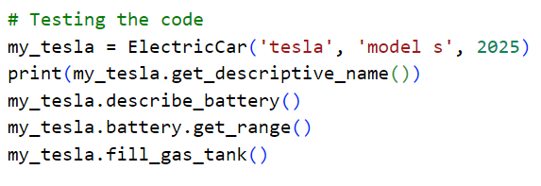
Page 172

Slide 17
Importing Classes
This topic covers the different ways to import and organize classes in Python for better code structure. To import a single class, we use the format from module_name import ClassName. Next, we can store multiple related classes in a single module, and to import multiple classes from a module, we separate each class name with commas like from module_name import Class1, Class2.
When importing an entire module, we use import module_name, and to import all classes from a module, the format is from module_name import *, though this is not recommended due to potential naming conflicts. Importing a module into another module allows classes from one module to be used in another, using from module_name import ClassName or import module_name.
Finally, aliases are used to shorten long module or class names, done by adding as alias_name in the import statement, such as from module_name import ClassName as AliasName or import module_name as alias_name.

Slide 18
To test out importing classes:
Create a folder that contains the following:
car.py
my_cars.py
electric_car.py
Page number:
car.py code is on page 174
my_cars.py code is on page 176, 177, 178
electric_car.py code is on page 177. This file should only contain from car import Car, class Battery and class ElectricCar(Car)

Slide 19
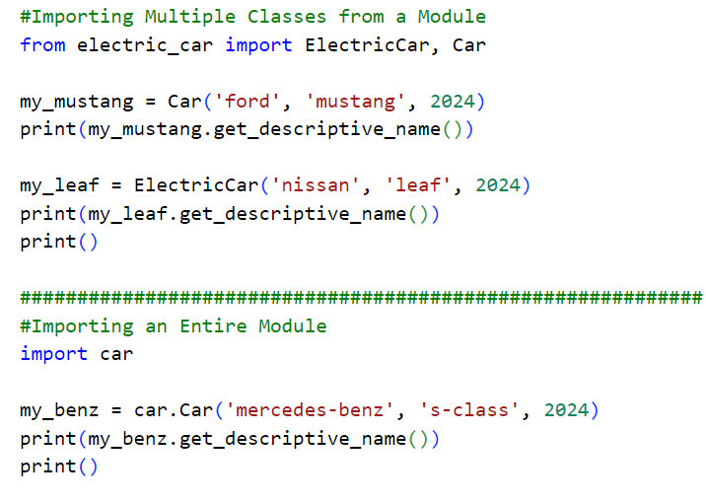
my_cars.py

Slide 20
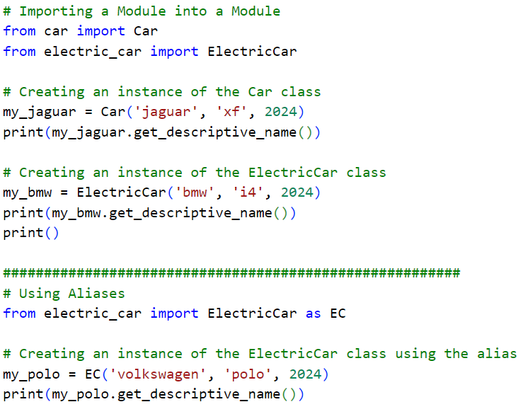

Slide 21
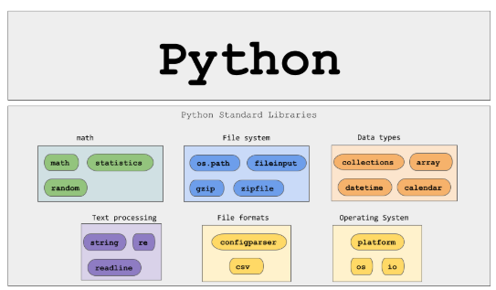
The Python Standard Library
The Python standard library is a set of modules included with every Python installation. Now that you have a basic understanding of how functions and classes work, you can start to use modules like these that other programmers have written. You can use any function or class in the standard library by including a simple import statement at the top of your file. Let’s look at one module, random, which can be useful in modeling many real-world situations.

Slide 22
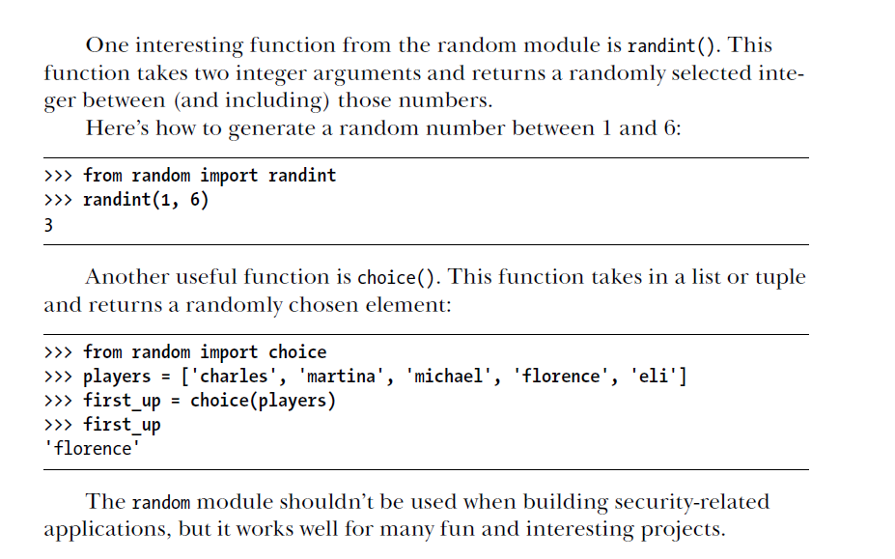

Slide 23
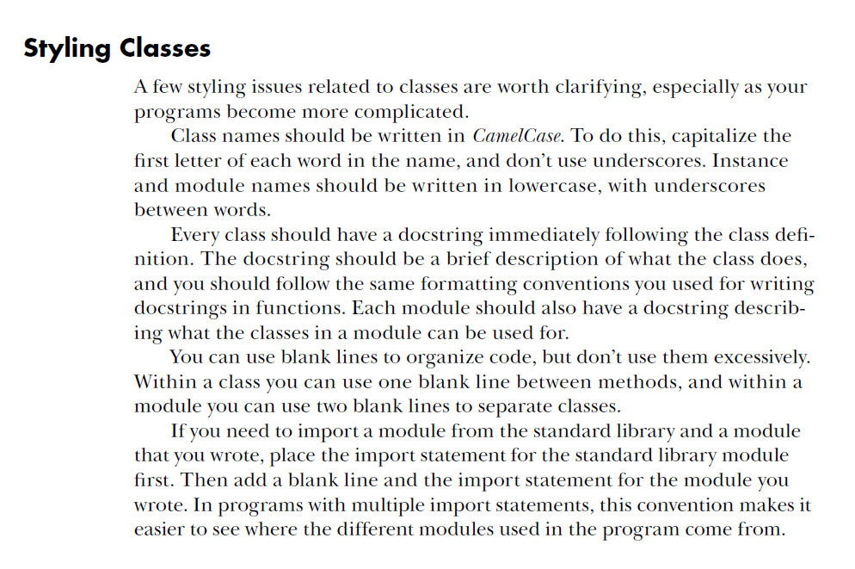

Slide 24
Practice Exercises
Do the following TRY IT YOURSELF on pages:
162
166
173
179
180

Slide 25

End
Of
Chapter 9

